Slide 1
Ch. 2
Structural Functionalism Theory

Slide 2
Ralph and Alice
What is their story?
Equilibrium = various parts of the ______, society, or family need to work together to be healthy, function properly and maintain a state of________.

Slide 3
Talcott Parsons
Behavior = drive to conform to societies’ _____ code
Moral code constrains human behavior
Promotes common good

Slide 4
Talcott Parsons
In order to survive subsystems (family & other institutions) must function in ways that _______survival or maintenance of society as a whole

Slide 5
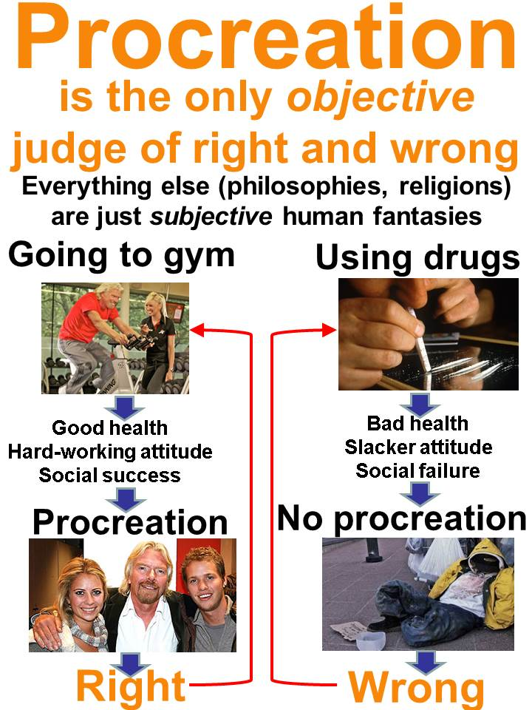

Slide 6
Parsons cont.
Shared norms and values key to survival of _____.
Deviation from shared norms = disorganization and _________ survival

Slide 7
Parsons cont.
Family system is key to survival of society
Any _________ from family norms threaten survival of family and society
What are some deviations?

Slide 8
Parsons Cont…
And then came the 60s
Felt _______ was the only way children learned culturally approved values

Slide 9
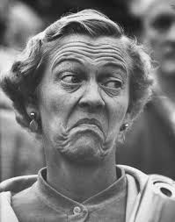
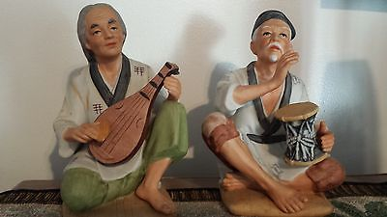
Parsons Cont…
Borrowed from Freud the concept of sexually driven roles of:
  ___________ men and _________ women within the ideal nuclear family.

Slide 10

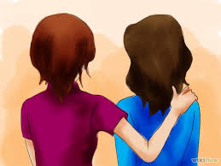
Parsons Cont…
What are instrumental and expressive roles?

Slide 11
Basic Assumptions
The function of families is to ________ and socialize children.
The intact nuclear family of husband, wife and children are the ______ structure to perform the functions of procreation and socialization
Largely supported by research

Slide 12
Basic Assumptions
All _______ have functions
The main function of any structure, including family, is to maintain its’ structure
The best way to maintain the family structure was to divide duties along _______ lines.

Slide 13

Basic Assumptions
Instrumental function belongs to males and includes providing for the ______ needs of the family

Slide 14
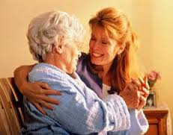
Basic Assumptions
Expressive function belongs to females and includes meeting _______ needs of the family and smoothing out problems

Slide 15
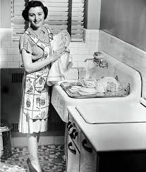
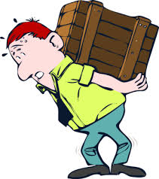
Basic Assumptions Cont…
Women are biologically better suited for ______ work while men are better suited for ______ work related to providing.

Slide 16
Additional Ways to Define Expressive vs. Instrumental
Expressive
  _________-status or what you were born with
  Diffuseness-wide variety of relationships meet a range of needs
Instrumental
  Achievement-What you have earned
  _________-Develop relationships to meet a specific need

Slide 17
Additional Ways to Define Expressive vs. Instrumental
Expressive
  Particularism-our behaviors are guided by the person with whom we are __________
Instrumental
  Universalism-we ___ a certain way based on societal norms and values

Slide 18
Additional Ways to Define Expressive vs. Instrumental
Expressive
  ___________-relationships based on love, trust, close personal involvement
Instrumental
  Affective Neutrality-relationships based on social exchange and _____

Slide 19
Additional Ways to Define Expressive vs. Instrumental
Expressive
  Collectivity-Focus is on the interest of _____, or the social group
Instrumental
  ____-Focus is on self-interest

Slide 20
Additional Ways to Define Expressive vs. Instrumental
Reactions?
When was this theory created?
What was unique about that time in U.S. history?

Slide 21
Primary Terms and Concepts
Equilibrium = family goals most easily reached when:
  shared by all members of the family
  when performed by differentiated or specialized roles.

Slide 22
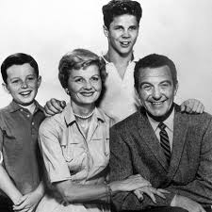
Primary Terms and Concepts
The Benchmark Family
Conformity→fulfilling
roles prescribed by
society.

Slide 23
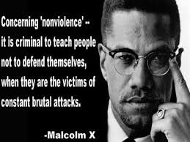
Deviant Behavior
Innovation→
striving for
socially
acceptable goals
using socially
____________
means.

Slide 24
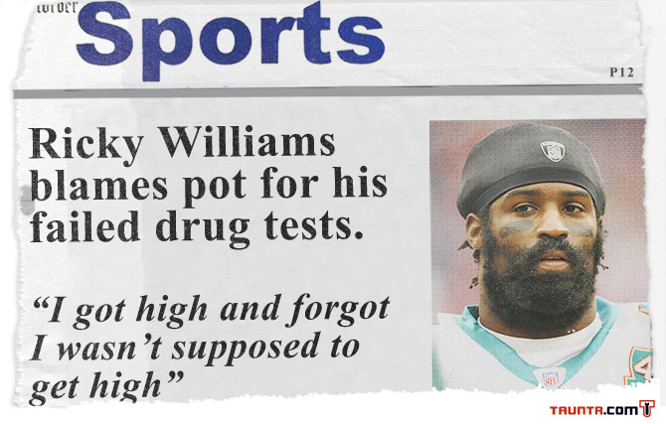
Retreatism→_________ both the socially acceptable goals and the means to obtain them.

Slide 25
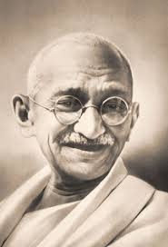
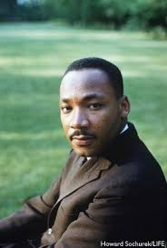
Rebellion→reject the normative goals and means to reach those goals and attempt to ______ a new social structure

Slide 26
Ritualism→continuing to strive for a _______ acceptable goal without hope of ever reaching it.

Slide 27
Murdock
What functions do families, marriages and children serve for society?
Sexual
Reproduction
Socialization
Economic

Slide 28
Short Video Summary
http://www.youtube.com/watch?v=5jOZqVnQmdY
Video with a macro perspective. Think family instead of society. (5:40).

Slide 29
In Class Activity!
One Parent or Five Report

